Slide 1
Day 2
Group Pi

Slide 2
Subnet Mask

Slide 3
Subnet Mask
To find the network number and broadcast number first convert the IP into binary. (Ignore the number after the slash for now)
192.168.2.42 / 24
192 . 168 . 2 . 42
11000000.10101000.0000010.00011000

Slide 4
Subnet Mask
Then count over the amount of bits specified by the number following the slash.
192.168.2.42 / 24
1 2 3 4 5 6 7 8 9 10 11 12 13 14 15 16 17 18 19 20 21 22 23 24
11000000.10101000.00000010|.00011000

Slide 5
Subnet Mask
Replace the rest of the numbers with X’s.
1 2 3 4 5 6 7 8 9 10 11 12 13 14 15 16 17 18 19 20 21 22 23 24
11000000.10101000.00000010|.00011000
11000000.10101000.00000010|.XXXXXXXX

Slide 6
Subnet Mask
To find the network number replace all the X’s with zeros and convert back to decimal.
11000000.10101000.00000010|.XXXXXXXX
11000000.10101000.00000010.00000000
192 . 168 . 2 . 42
Network Number: 192.168.2.0

Slide 7
Subnet Mask
To find the broadcast number replace all the X’s with ones and convert back to decimal.
11000000.10101000.00000010|.XXXXXXXX
11000000.10101000.00000010.111111111
192 . 168 . 2 . 255
Broadcast Number: 192.168.2.255

Slide 8
Subnet Mask
To find the amount of viable IP’s take 2 and raise it to the power of 32 minus the net mask number and subtract two.
192.168.2.42 / 24
2^(32-24) = 2^8 = 256
256 - 2 = 254
Viable IP’s: 254

Slide 9
Subnet Mask
The IP range is between the network number and the broadcast number(non-inclusive).
Network Number: 192.168.2.0
Broadcast Number: 192.168.2.255
Viable IP’s: 254

Slide 10
Packet Tracer

Slide 11
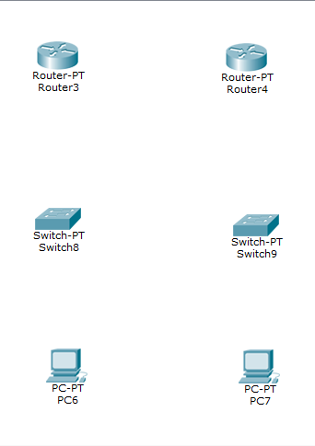
Setting Up a basic Network
To set up a simple network you need to add two routers, two switches, and two PC’s in this or a similar formation.

Slide 12
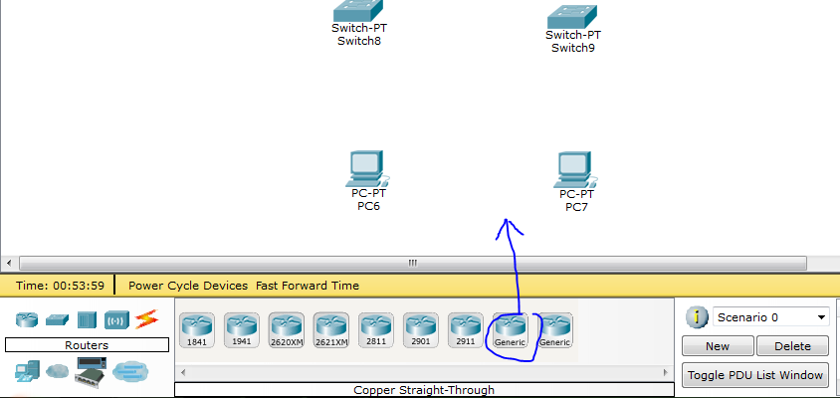
Setting Up a basic Network
You add new components by clicking the category then clicking and dragging an item into the workspace.

Slide 13
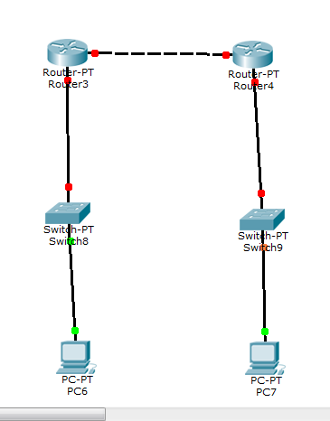
Setting Up a basic Network
After you have you need to connect everything. By using the same method drag cables out and click on a node. It will bring up a menus of ports to connect to. Choose a fast ethernet port, then repeat the process on another node to connect them.

Slide 14
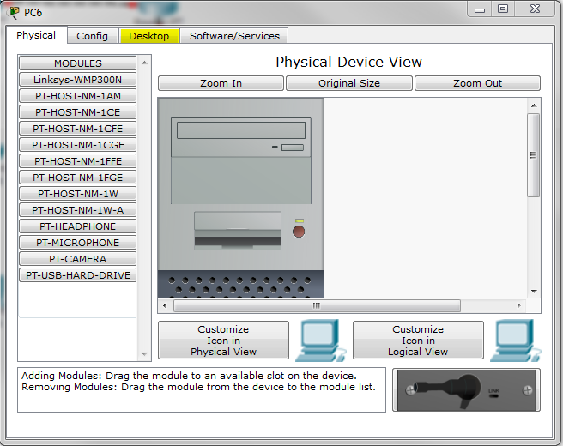
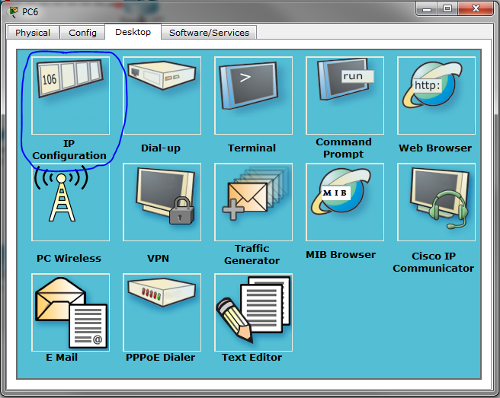
Setting Up a basic Network
Now you need to assign the computers IP’s. Double click to open a computer’s menu.
Then click Desktop.
Then IP Configuration.

Slide 15
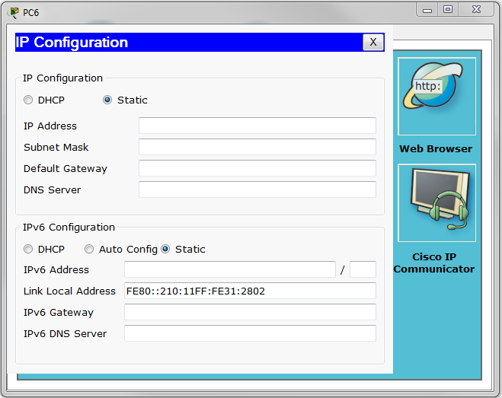
Setting Up a basic Network
Now you must enter a valid IP, Subnet Mask and Default Gateway.
Do this for both computers.

Slide 16
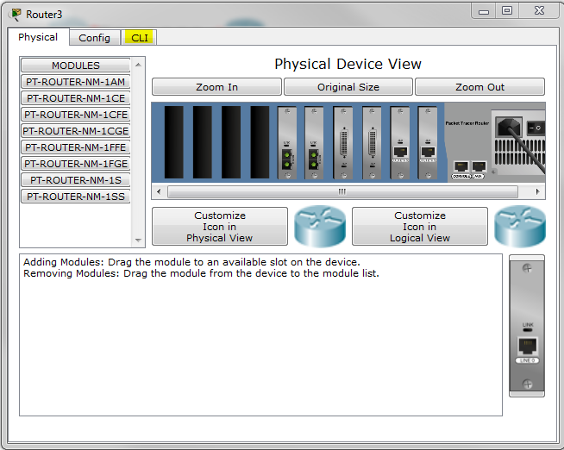
Setting Up a basic Network
Now open the router menu, and click on the CLI tab.

Slide 17
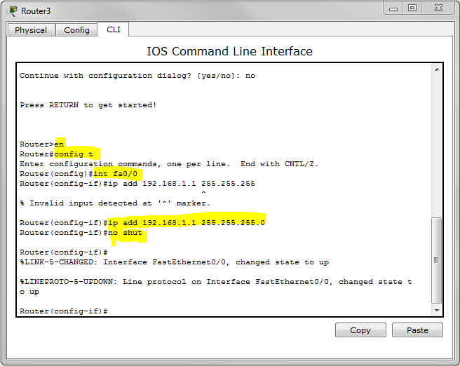
Setting Up a basic Network
Type these into the interface:
-en
-conf t
Each port must be configured so follow these commands for each port
-int fa<port>
-ip add <ip> <subnet>
-no shut
-exit

Slide 18
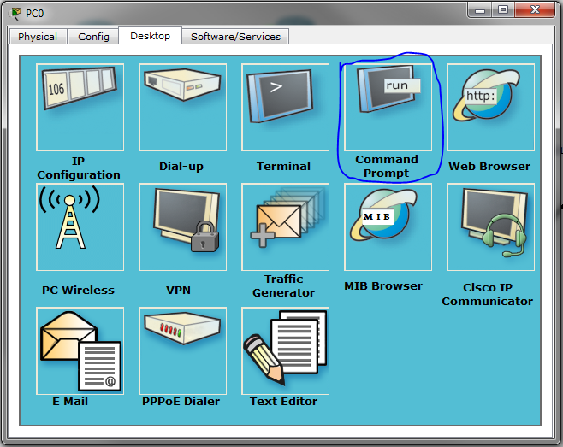
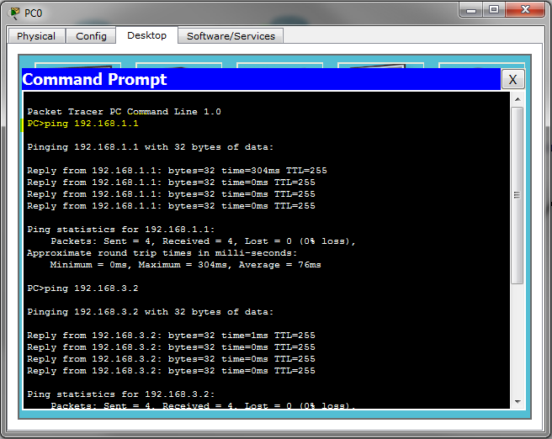
Setting Up a basic Network
Now test the network by bring up the computer desktop again. Click on the Command Prompt. Then type ‘ping <address>’, address being a IP on the network. A reply indicates functionality.

Slide 19
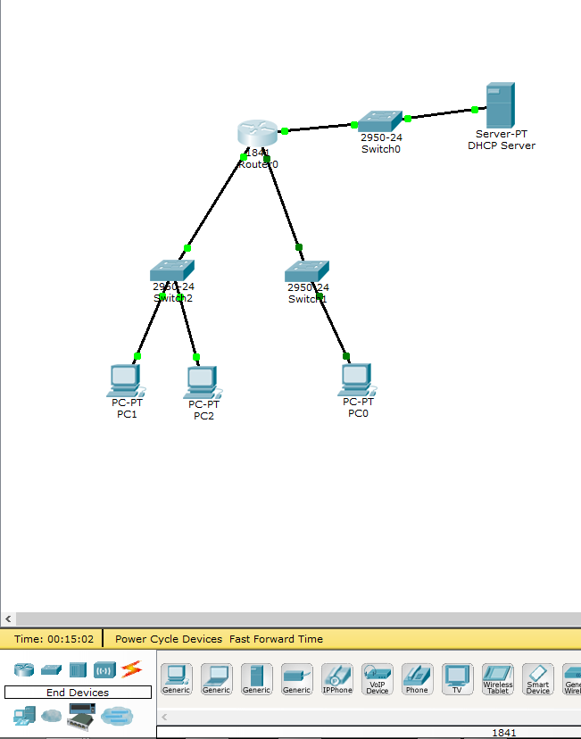
Setting Up DHCP
First setup the configuration like this by dragging and dropping the items you need from the menu below

Slide 20
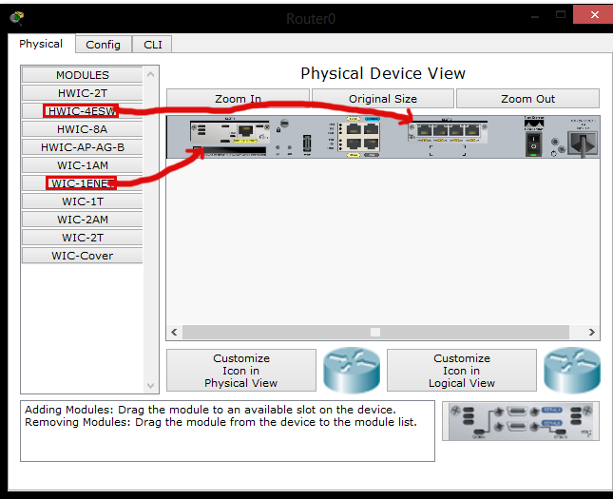
Setting Up DHCP
Next we need to add some hardware to the router so it can accept 3 inputs

Slide 21
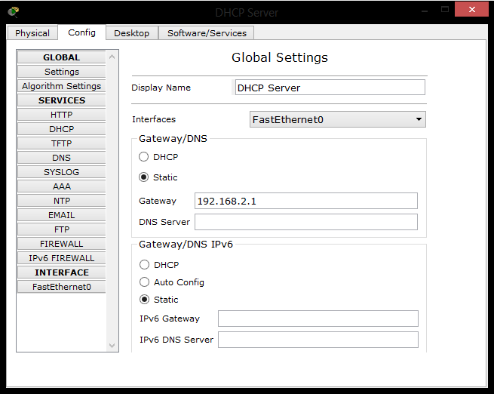
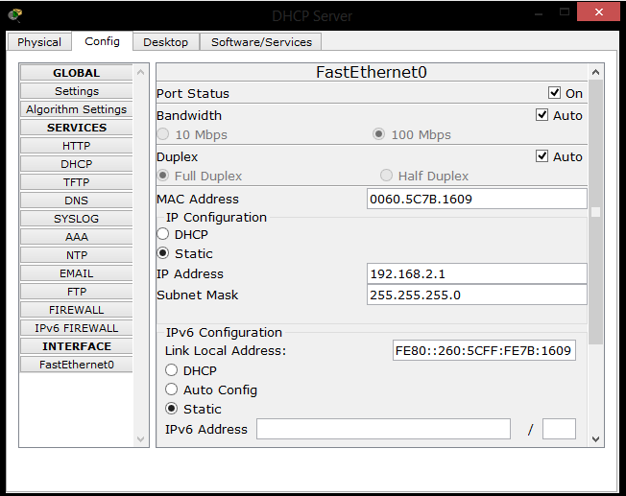
Setting Up DHCP
Now we configure the server as a DHCP server. Set the IP of the server itself as static in the global settings and on FastEthernet0.

Slide 22
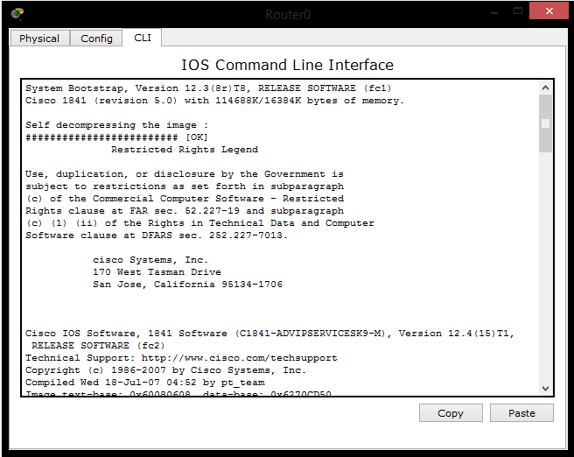
Setting Up DHCP
Use the command line interface to set the ips of the interfaces in the router

Slide 23
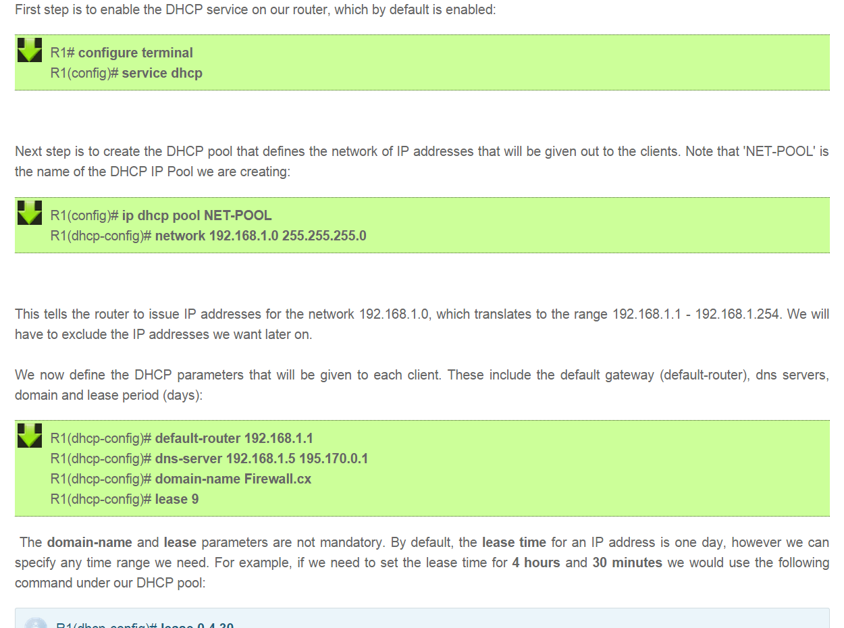
Setting Up DHCP
Then we followed the directions from http://www.firewall.cx/cisco-technical-knowledgebase/cisco-routers/812-cisco-router-dhcp-config.html to set up the router to forward the DHCP from the server

Slide 24
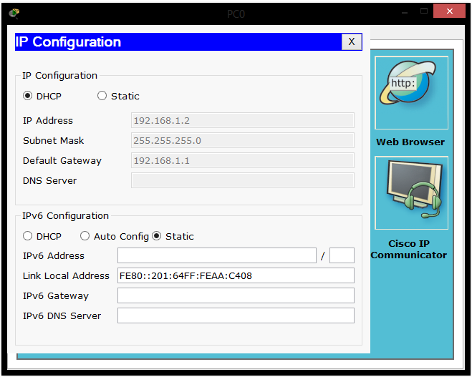
Setting Up DHCP
Then set the ip configuration of each pc to DHCP.

Slide 25
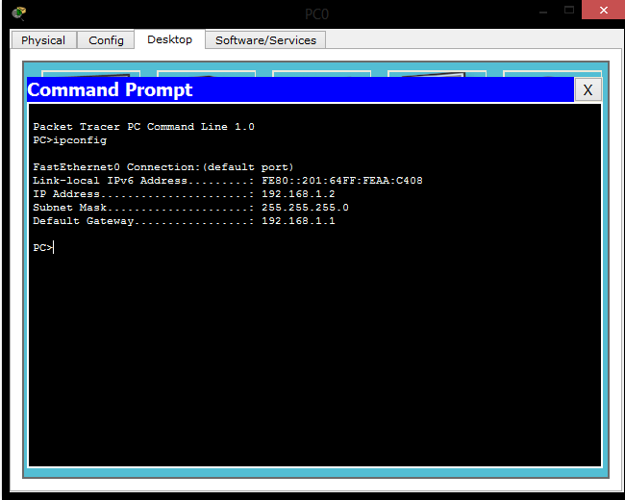
Setting Up DHCP
And finally go to command prompt in a pc and type “ipconfig” and it should return the ip address it was given.

Slide 26
Resources
Help From:
Resources on team server
Team Leaders
http://www.firewall.cx/cisco-technical-knowledgebase/cisco-routers/812-cisco-router-dhcp-config.html

